Slide 1

Artificial Intelligence Lecture 06: Uninformed Search
Farhad Muhammad Riaz

Slide 2
Uninformed Search
Uninformed: While searching you have no clue whether one non-goal state is better than any other. Your search is blind. You don’t know if your current exploration is likely to be fruitful.
Various blind strategies:
Breadth-first search
Uniform-cost search
Depth-first search
Iterative deepening search

Slide 3
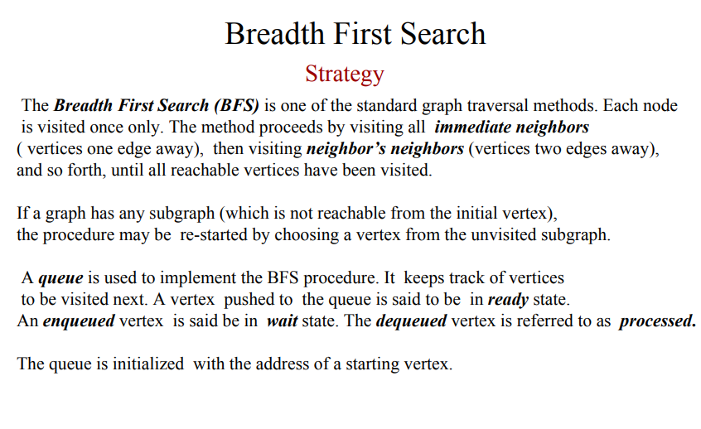
Breadth-first search

Slide 4
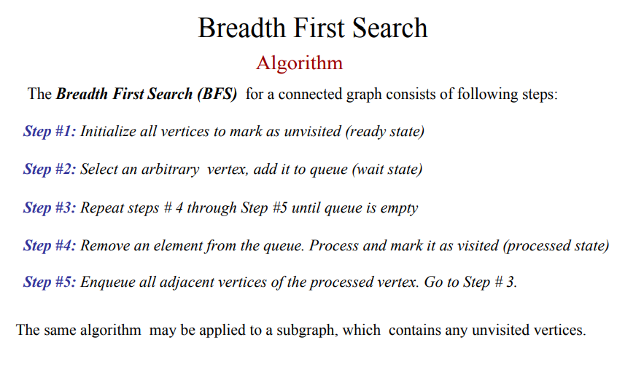
Breadth-first search

Slide 5
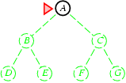
Breadth-first search
Expand shallowest unexpanded node
Fringe: nodes waiting in a queue to be explored
Implementation:
fringe is a first-in-first-out (FIFO) queue, i.e., new successors go at end of the queue.
Is A a goal state?

Slide 6
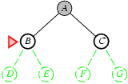
Breadth-first search
Expand shallowest unexpanded node
Implementation:
fringe is a FIFO queue, i.e., new successors go at end
Expand:
fringe = [B,C]
Is B a goal state?

Slide 7
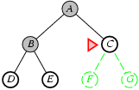
Breadth-first search
Expand shallowest unexpanded node
Implementation:
fringe is a FIFO queue, i.e., new successors go at end
Expand:
fringe=[C,D,E]
Is C a goal state?

Slide 8
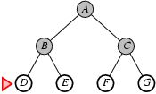
Breadth-first search
Expand shallowest unexpanded node
Implementation:
fringe is a FIFO queue, i.e., new successors go at end
Expand:
fringe=[D,E,F,G]
Is D a goal state?

Slide 9
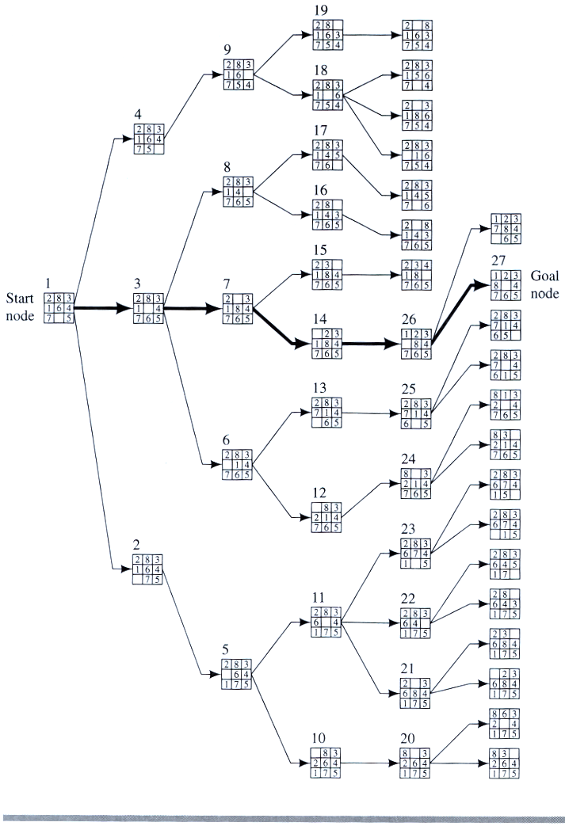
Breadth-first search

Slide 10
Properties of breadth-first search
Complete? Yes it always reaches goal (if b is finite)
Time? 1+b+b²+b³+… +b^{d} + (b^{d+1}-b)) = O(b^{d+1})
(this is the number of nodes we generate)
Space? O(b^{d+1}) (keeps every node in memory,
either in fringe or on a path to fringe).
Optimal? Yes (if we guarantee that deeper solutions are less optimal, e.g. step-cost=1).
Space is the bigger problem (more than time)

Slide 11
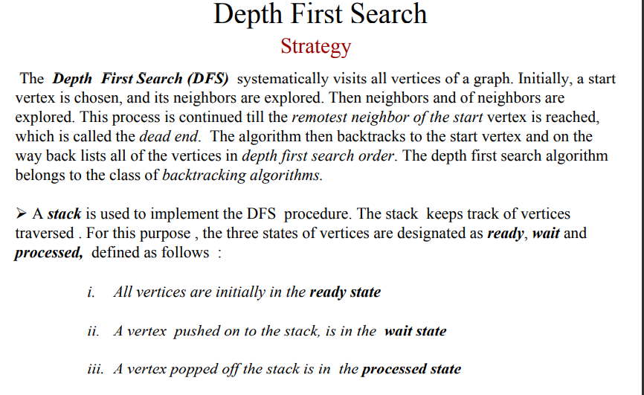
Depth-first search

Slide 12
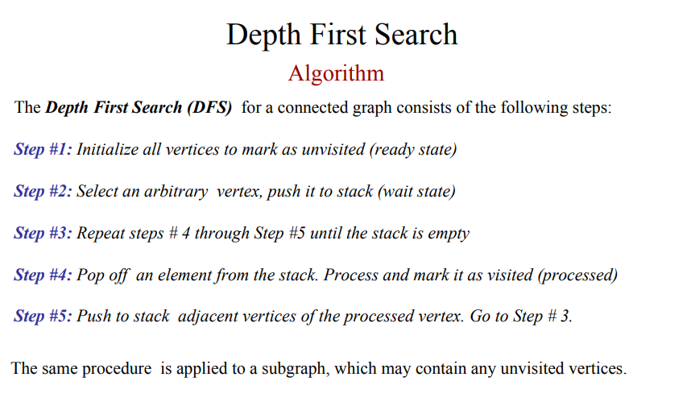
Depth-first search

Slide 13
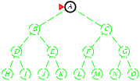
Depth-first search
Expand deepest unexpanded node
Implementation:
fringe is a LIFO queue, i.e., put successors in the front

Slide 14
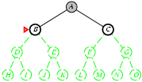
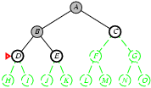
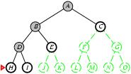
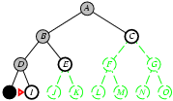

Slide 15
Properties of Depth-first search
Complete? No: fails in infinite-depth spaces, spaces with loops
Complete in finite spaces
Time? O(b^{m}): terrible if m is much larger than d
But if solutions are dense, may be much faster than breadth-first
Space? O(bm), i.e., linear space!
Optimal? No

